Slide 1
Microservices architecture
Sarah Williams
Notes:
Information in this document, including URL and other Internet Web site references, is subject to change without notice. Unless otherwise noted, the example companies, organizations, products, domain names, e-mail addresses, logos, people, places, and events depicted herein are fictitious, and no association with any real company, organization, product, domain name, e-mail address, logo, person, place or event is intended or should be inferred. Complying with all applicable copyright laws is the responsibility of the user. Without limiting the rights under copyright, no part of this document may be reproduced, stored in or introduced into a retrieval system, or transmitted in any form or by any means (electronic, mechanical, photocopying, recording, or otherwise), or for any purpose, without the express written permission of Microsoft Corporation.
Microsoft may have patents, patent applications, trademarks, copyrights, or other intellectual property rights covering subject matter in this document. Except as expressly provided in any written license agreement from Microsoft, the furnishing of this document does not give you any license to these patents, trademarks, copyrights, or other intellectual property.
The names of manufacturers, products, or URLs are provided for informational purposes only and Microsoft makes no representations and warranties, either expressed, implied, or statutory, regarding these manufacturers or the use of the products with any Microsoft technologies. The inclusion of a manufacturer or product does not imply endorsement of Microsoft of the manufacturer or product. Links may be provided to third party sites. Such sites are not under the control of Microsoft and Microsoft is not responsible for the contents of any linked site or any link contained in a linked site, or any changes or updates to such sites. Microsoft is not responsible for webcasting or any other form of transmission received from any linked site. Microsoft is providing these links to you only as a convenience, and the inclusion of any link does not imply endorsement of Microsoft of the site or the products contained therein.
© 2017 Microsoft Corporation. All rights reserved.
Microsoft and the trademarks listed at https://www.microsoft.com/en-us/legal/intellectualproperty/Trademarks/Usage/General.aspx are trademarks of the Microsoft group of companies. All other trademarks are property of their respective owners.

Slide 2
Agenda
Introductions
You to me
Me to you
Introduction to Microservices & Service Fabric
Whiteboard session
Hands on lab

Slide 3
Relax, learn and enjoy
This is a relaxed environment
This is a safe space
There is no such thing as a stupid question
Talk to each other, learn from each other, collaborate
Enjoy the day!

Slide 4
Questions
Please feel free to ask questions at appropriate times as we go through
Don’t be offended if I note down your question and move things along. I’ll do my best to answer all the questions even if I can’t answer them in the moment

Slide 5
Introductions
You to me
What’s your name?
What’s the name of your company and what does the company do?
What’s your job?
Have you done anything with Microservices before?
Me to you
Sarah Williams
Consultant, architect, developer

Slide 6
Introduction to Microservices & Service Fabric

Slide 7
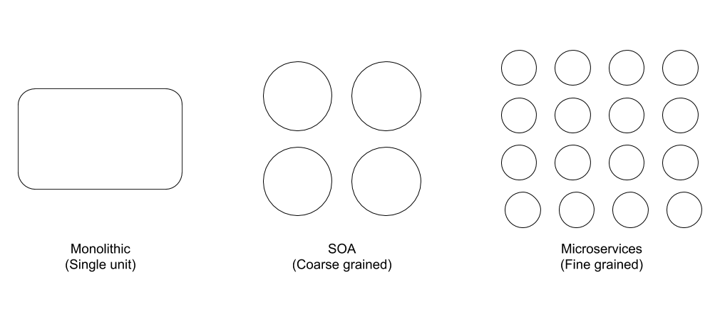
Why are Microservices a thing?
Monolithic architecture has a lot of pain points
Service Oriented Architecture started the work
Microservices are an evolution of SOA
Notes:
Monolithic applications are expensive to scale and difficult to work on, it’s hard to change one part without affecting another (tightly coupled). Require lots of time and energy for testing
SOA has largely been quite successful as a design style but it is difficult to get right as it’s hard to decide how to size a service, so can often still result in partly monolithic applications
You might hear to it referred to as “SOA done well” although I disagree and I’m not sure that’s very fair. SOA can be done well and I think Microservices are just an evolution that offers new possibilities now that we have the tools to fully support teams using microservices (Service Fabric, Docker, Kubernetes, AKS (Azure Kubernetes Service), the rise of PaaS cloud infrastructure like Azure Functions)

Slide 8
The benefits
Scalability
Testability
Deployability
Team per service
Productivity
Resilience
Reduced complexity
Freedom to choose the technology
Notes:
Scalability
You can scale each distinct part as required. For example, if you have an ecommerce site and you have loads of orders coming in, you can scale up just that one service and leave the others alone
Testability
Services are smaller and faster to test
Deployability
Services can be deployed independently when they’re ready to go without waiting for changes elsewhere in the system
Team per service
Probably more relevant to quite large systems and teams but the ability to have a team who know a service inside out working on it and scaling it independently can be beneficial
Productivity
Smaller, more distinct services mean they can be easier for a developer to understand, the IDE will perform better, local instances will run better, they’re faster to deploy
Resilience
If a service dies, you can spin up a new one while the rest of the system continues to function
Reduced complexity
This isn’t to say a microservice can’t be complex. But a single complex microservice is better than a monolith with lots of tightly coupled complexity
Freedom to choose the technology
If most of your Microservices are in .Net, but you identify the need for a new one and it’s better suited to being written in Go, then there’s no technical barrier to doing that. It’s important not to go too far with this though as it could become a disadvantage. No coherence for the codebase or system design, distributed skills etc

Slide 9
It’s not all good news
Distributed systems are complex
Testing is more difficult
IDE’s were designed for monoliths
Can require extra code
Coordination is key
Notes:
Microservices aren’t a silver bullet. There’s a lot of hype around them, but that doesn’t mean they’re always the right choice for your architecture. It’s important to also know the downsides.
Distributed systems are complex
Despite reduced complexity being a benefit of Microservices in terms of each service having reduced complexity, the way the architecture as a whole works as a distributed system can be quite complex
Testing is more difficult
You get better testability of each discrete service, but you will need to consider extra integration tests too though because of the nature of distributed systems
IDE’s were designed for monoliths
They’re more oriented on building monoliths and don’t provide explicit support for developing distributed applications
Can require extra code
Requests between services have to be handled carefully. You might need to write extra code to avoid disruption if a service fails and network latency can also cause problems you’ll need to consider
Coordination is key
If you’ve split your teams by service, you’ll probably often get a use case that needs a solution that will span multiple services so teams need to be able to communicate and coordinate effectively
It’s important to consider these challenges and make sure you have the things in place to help mitigate them when choosing Microservices.

Slide 10
Microservices with Service Fabric
“Azure Service Fabric is a distributed systems platform that makes it easy to package, deploy, and manage scalable and reliable microservices and containers. Service Fabric also addresses the significant challenges in developing and managing cloud native applications. Developers and administrators can avoid complex infrastructure problems and focus on implementing mission-critical, demanding workloads that are scalable, reliable, and manageable. Service Fabric represents the next-generation platform for building and managing these enterprise-class, tier-1, cloud-scale applications running in containers.”

Slide 11
Service Fabric Programming Models
Containers
Reliable Services
Reliable Actors
ASP.NET Core
Guest Executables
Notes:
Containers
By default, Service Fabric deploys and activates services as processes. Service Fabric can also deploy services in containers. Importantly, you can mix services in processes and services in containers in the same application. Service Fabric supports deployment of Linux containers and Windows containers on Windows Server 2016. You can deploy existing applications, stateless services, or stateful services in containers.
Reliable Services
Reliable Services is a lightweight framework for writing services that integrate with the Service Fabric platform and benefit from the full set of platform features. Reliable Services can be stateless (similar to most service platforms, such as web servers or Worker Roles in Azure Cloud Services), where state is persisted in an external solution, such as Azure DB or Azure Table Storage. Reliable Services can also be stateful, where state is persisted directly in the service itself using Reliable Collections. State is made highly available through replication and distributed through partitioning, all managed automatically by Service Fabric.
Reliable Actors
Built on top of Reliable Services, the Reliable Actor framework is an application framework that implements the Virtual Actor pattern, based on the actor design pattern. The Reliable Actor framework uses independent units of compute and state with single-threaded execution called actors. The Reliable Actor framework provides built in communication for actors and pre-set state persistence and scale-out configurations.
ASP.NET Core
Service Fabric integrates with ASP.NET Core as a first class programming model for building web and API applications. ASP.NET Core can be used in two different ways in Service Fabric:
Hosted as a guest executable. This is primarily used to run existing ASP.NET Core applications on Service Fabric with no code changes.
Run inside a Reliable Service. This allows better integration with the Service Fabric runtime and allows stateful ASP.NET Core services.
Guest Executables
A guest executable is an existing, arbitrary executable (written in any language) hosted on a Service Fabric cluster alongside other services. Guest executables do not integrate directly with Service Fabric APIs. However they still benefit from features the platform offers, such as custom health and load reporting and service discoverability by calling REST APIs. They also have full application lifecycle support.

Slide 12
Why use Reliable Services?
Access to Service Fabric APIs
A simple model for your code
A pluggable communication model
For stateful services, use of Reliable Collections
Reliability
Availability
Scalability
Consistency
Notes:
Access to Service Fabric APIs
Unlike Service Fabric Services modelled as Guest Executables, Reliable Services get to use the rest of the Service Fabric APIs directly. This allows services to:
query the system
report health about entities in the cluster
receive notifications about configuration and code changes
find and communicate with other services,
(optionally) use the Reliable Collections
...and giving them access to many other capabilities, all from a first class programming model in several programming languages.
A simple model for your code
A simple model for running your own code that looks like programming models you are used to. Your code has a well-defined entry point and easily managed lifecycle.
A pluggable communication model
Use the transport of your choice, such as HTTP with Web API, WebSockets, custom TCP protocols, or anything else. Reliable Services provide some great out-of-the-box options you can use, or you can provide your own.
For stateful services, use of Reliable Collections
For stateful services, the Reliable Services programming model allows you to consistently and reliably store your state right inside your service by using Reliable Collections. Reliable Collections are a simple set of highly available and reliable collection classes that will be familiar to anyone who has used C# collections. Traditionally, services needed external systems for Reliable state management. With Reliable Collections, you can store your state next to your compute with the same high availability and reliability you've come to expect from highly available external stores. This model also improves latency because you are co-locating the compute and state it needs to function.
Reliability
Your service stays up even in unreliable environments where your machines fail or hit network issues, or in cases where the services themselves encounter errors and crash or fail. For stateful services, your state is preserved even in the presence of network or other failures.
Availability
Your service is reachable and responsive. Service Fabric maintains your desired number of running copies.
Scalability
Services are decoupled from specific hardware, and they can grow or shrink as necessary through the addition or removal of hardware or other resources. Services are easily partitioned (especially in the stateful case) to ensure that the service can scale and handle partial failures. Services can be created and deleted dynamically via code, enabling more instances to be spun up as necessary, say in response to customer requests. Finally, Service Fabric encourages services to be lightweight. Service Fabric allows thousands of services to be provisioned within a single process, rather than requiring or dedicating entire OS instances or processes to a single instance of a service.
Consistency
Any information stored in this service can be guaranteed to be consistent. This is true even across multiple reliable collections within a service. Changes across collections within a service can be made in a transactionally atomic manner.

Slide 13
Why use Reliable Actors?
Can execute simultaneously and independently of one another
Your problem involves a large number of small, independent units of state and logic
You want to work with single threaded objects
Doesn’t issue I/O operations
Scalability & Reliability
Notes:
Can execute simultaneously and independently of one another
An actor is an isolated, independent unit of compute and state with single-threaded execution. The actor pattern is a computational model for concurrent or distributed systems in which a large number of these actors can execute simultaneously and independently of each other. Actors can communicate with each other and they can create more actors.
Your problem involves a large number (thousands or more) of small, independent, and isolated units of state and logic
You want to work with single threaded objects
You want to work with single-threaded objects that do not require significant interaction from external components, including querying state across a set of actors.
Doesn’t issue I/O operations
Your actor instances won't block callers with unpredictable delays by issuing I/O operations.
Scalability & Reliability
To provide scalability and reliability, Service Fabric distributes actors throughout the cluster and automatically migrates them from failed nodes to healthy ones as required. This is an abstraction over a partitioned, stateful Reliable Service. Distribution, scalability, reliability, and automatic failover are all provided by virtue of the fact that actors are running inside a stateful Reliable Service called the Actor Service.
Each Reliable Actor service you write is actually a partitioned, stateful Reliable Service.
Every actor is defined as an instance of an actor type, identical to the way a .NET object is an instance of a .NET type. For example, there may be an actor type that implements the functionality of a calculator and there could be many actors of that type that are distributed on various nodes across a cluster. Each such actor is uniquely identified by an actor ID.

Slide 14
Stateless and Stateful Microservices for Service Fabric
Stateless microservices
Do not maintain state outside a request & response
E.g. proxies, web gateways, Cloud Services worker roles
Stateful microservices
Maintain state beyond the request & response
E.g. user accounts, databases, shopping carts, queues
Service Fabric has a strong focus on stateful services
Notes:
Stateless microservices
Don’t maintain a mutable state outside a request and its response from the service
Stateful microservices
Maintain a mutable, authoritative state beyond the request and its response
Service Fabric has a strong focus on stateful services
A key differentiation with Service Fabric is its strong focus on building stateful services, either with the built in programming models like “reliable services” and “reliable actors”, or with containerised stateful services
Why have stateful microservices along with stateless ones? The two main reasons are:
You can build high-throughput, low-latency, failure-tolerant online transaction processing (OLTP) services by keeping code and data close on the same machine. Some examples are interactive storefronts, search, Internet of Things (IoT) systems, trading systems, credit card processing and fraud detection systems, and personal record management.
You can simplify application design. Stateful microservices remove the need for additional queues and caches, which are traditionally required to address the availability and latency requirements of a purely stateless application. Stateful services are naturally high-availability and low-latency, which reduces the number of moving parts to manage in your application as a whole.

Slide 15
Whiteboard design session
http://bit.ly/mcw-microservices

Slide 16
Abstract and learning objectives
In this whiteboard design session, you will work in a group to design a solution that leverages aspects from microservices and serverless architectures to help an online concert ticket vendor survive the first five minutes of crushing load. You will handle the client's scaling needs through microservices built on top of Service Fabric and apply smooth updates or roll back failing updates. Finally, your group will design an implementation of load testing to optimize the architecture for handling spikes in traffic.
At the end of this whiteboard design session, you will better be able to design scalable microservices solutions involving Service Fabric and Azure Functions.
Notes:
This is an introduction to the Cloud Workshop at a high level. Later we’ll get into customer objections, requirements, etc… but we want to ground the participants on the business outcomes we’re going after for the day.

Slide 17
Step 1: Review the customer case study
Outcome
Analyze your customer needs.
Timeframe
15 minutes

Slide 18
Customer situation
Contoso Events is an online ticket provider experiencing consistent growth.
They have plans to further growth demand.
They want to extend customer reach through partners.
They plan to retire and replace existing customer solution.
Notes:
Contoso Events is an online service provider for concerts, sporting and other large event ticket sales.
Contoso Events has experienced consistent growth trends
Has marketing and partner engagement plans to further grow demand.
They plan to extend customer reach through partners by exposing its core event ticket sales and reporting APIs to partners.
They plan to retire and replace their existing solution in order to serve customers with a better experience – preserving code where possible.
The current Contoso Events solution consists of a collection of web sites implemented in ASP.NET
SQL Server back-end
Hosted by Azure on Virtual Machines (VMs)

Slide 19


Customer situation
Concerned about performance, scale, and costs
They desire a decoupled design
Interested in microservices, Service Fabric, and serverless architectures.
Looking for strategy for exposing APIs to partners
Notes:
They are concerned about performance, scale and costs as they grow.
Must be able to handle significant increases in demand during peak periods – such as when a popular event has tickets first go on sale.
They want to meet the demand of peak traffic periods while conserving costs during non-peak periods.
They will create mobile apps for iPhone, Android and Windows Phone devices.
They would like to investigate options for optimizing hosting and related operational costs.
They want to migrate to a decoupled design with improved business agility
They have challenges rolling out new features and supporting new events on demand. The code base has many interdependencies and this increases the risk of regressions across features when changes are introduced.
The ticket ordering process is a pain point as the data model for new events is often slightly different – which means that supporting new events may have impact on the user experience and UI, the middle tier and storage.
Rolling out changes that impact this area while upwards of 50,000 users are actively placing orders, has proven to be a fragile process and requires them to schedule down time to ensure safe deployment.
The CIO has heard about microservices, and is interested in exploring how Service Fabric, Azure Functions and supporting Azure features may help the team:
Increase agility in their development cycle
Decrease impact across features
Support continuous delivery
Keep operations lean
Keep costs contained during peak loads
In addition, they want a solid strategy for exposing APIs to partners in a secure and manageable way

Slide 20

Customer needs
Event tickets can be orders from multiple channels.
Customers must be registered/logged in to place orders.
Admin site for order management and reports.
Ability to rapidly release new features, while reducing downtime.
Reduce downtime caused by system updates.
Notes:
Event tickets can be ordered from multiple channels: the web site, new mobile applications, and third-party site and applications via available APIs.
Customers must be registered / logged in to place orders, so that they can login and find their orders, and for reporting and analytics purposes.
Internal staff will manage orders and view reports from the Admin site.
The ability to rapidly release new features that may involve UI, business logic and data model changes. Reduce dependency across features.
Reduced overall downtime caused by system updates. Rollouts must be possible without scheduled downtime. Rollbacks must be possible in the event of failure.

Slide 21
Customer needs
Be able to handle unpredictable spikes in demand
Improved operations management
Migrate to Cosmos DB
Secure API management
Integration with third-party credit card processor
Notes:
The solution must be able to handle increased system load for ticket purchasing including higher peak periods without excessive increases in management overhead and cost.
Operations management overhead must be improved through better system monitoring, visibility, self-healing services and auto-scale features.
The customer has decided to migrate from SQL Server to Cosmos DB for a more flexible schema and increased scalability across features.
A solution for securing and managing APIs used internally and by external partners with ability to easily publish, version, onboard consumers, control policy, monitor and audit usage.
The solution currently processes credit cards with a third-party payment-processing provider. This aspect of the solution will remain the same but require integration into the new design.

Slide 22

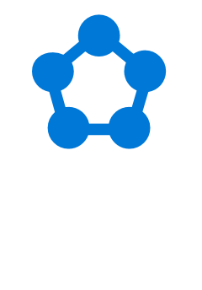

Customer objections
Is Service Fabric the right solution?
Which of our existing skills can be applied to microservices and Service Fabric?
Can stateful services or actors help us with ticket ordering throughput?
How and where can stateful services and actors help us?
How can Azure Functions be leveraged?
Notes:
While we are interested in the microservices approach, we are still comparing Service Fabric with PaaS features such as App Services and SQL DB. Service Fabric seems relatively new, while App Services and SQL DB have been around for some time.
Microservices architectures are completely new to the Contoso Events team. If we were to go forward with Service Fabric, we would like to understand what skills the team can carry forward, and how much of a learning curve exists.
We’d like to understand if stateful services or stateful actors will help us with ticket ordering throughput, workflow and state management, and easier rollouts of changes to this process.
We are not clear how and where to incorporate stateful services and actors alongside other storage such as Cosmos DB. We need the ability to support robust ad-hoc queries against our system data such as events, customers, orders and related metrics – but would like to take advantage of the performance and reliability of Service Fabric stateful options as well.
Could we consider Azure Functions as an alternative back end implementation for our APIs?

Slide 23
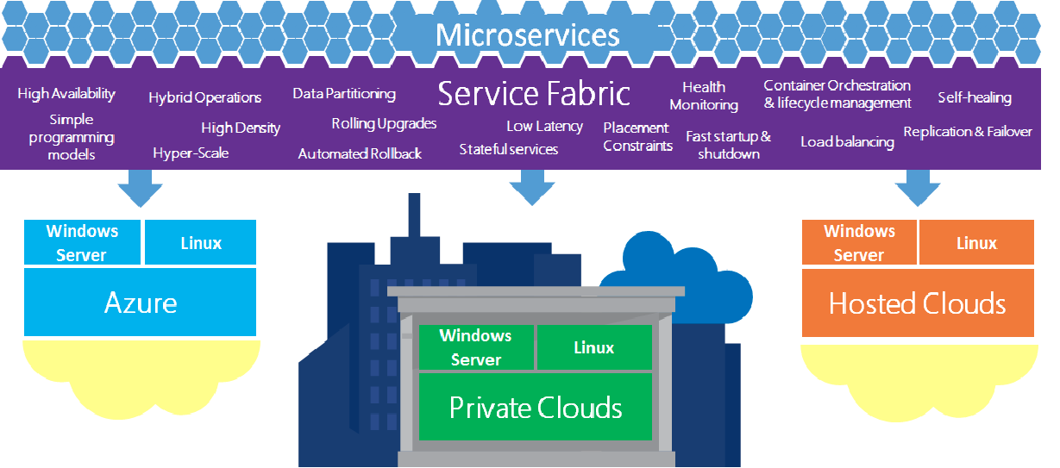
Common scenarios
Service Fabric overview
Notes:
This diagram represents a Service Fabric overview for this type of scenario, from which you can draw inspiration. You will find this diagram within the Whiteboard Design Session Student Guide.

Slide 24
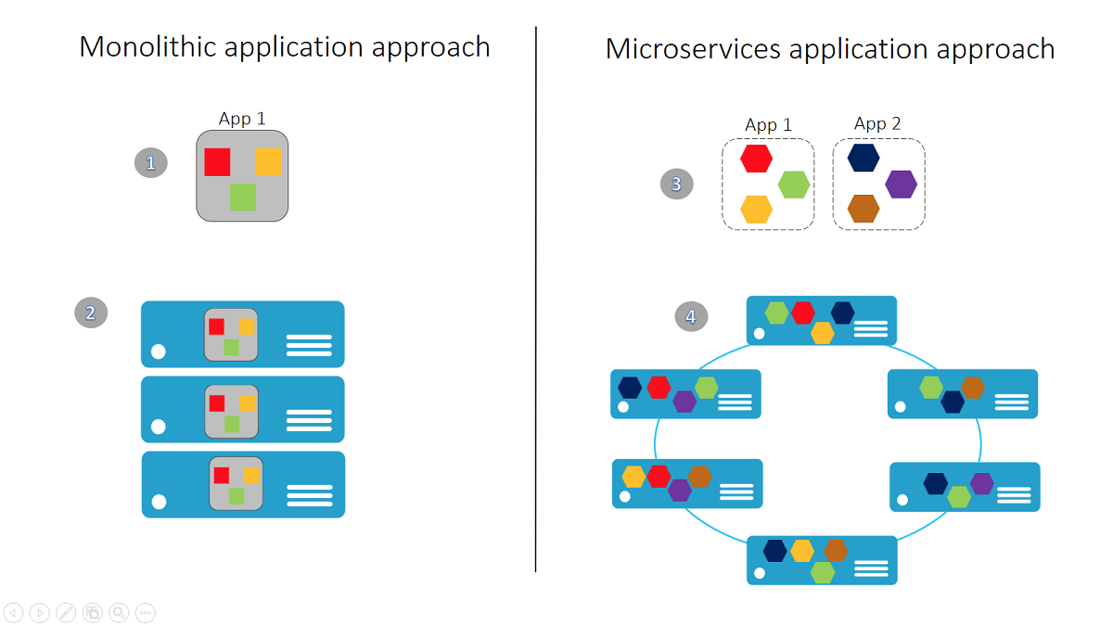
Common scenarios
Monolithic vs. Microservices approach
Notes:
This diagram presents a comparison of monolithic versus microservices approaches for this type of scenario, from which you can draw inspiration. You will find this diagram within the Whiteboard Design Session Student Guide.

Slide 25
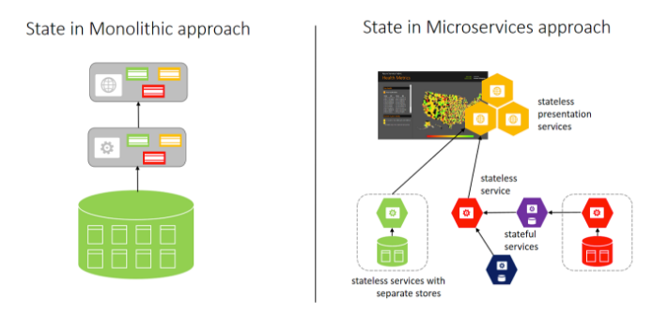
Common scenarios
Monolithic vs. Microservices – storage state
Notes:
This diagram presents a comparison of State storage in monolithic versus microservices approaches, from which you can draw inspiration. You will find this diagram within the Whiteboard Design Session Student Guide.

Slide 26
Step 2: Design the solution
Outcome
Design a solution and prepare to present the solution to the target customer audience in a 15-minute chalk-talk format.
Timeframe
60 minutes
Business needs (15 minutes) | Respond to questions outlined in your guide and list the answers on a flipchart
Design (35 minutes) | Design a solution for as many of the stated requirements as time allows. Show the solution on a flipchart.
Prepare (15 minutes) | Identify any customer needs that are not addressed with the proposed solution Identify the benefits of your solution Determine how you will respond to the customer’s objections Prepare for a 15-minute presentation to the customer

Slide 27
Step 3: Present the solution
Outcome
Present a solution to the target customer in a 15-minute chalk-talk format .
Timeframe
30 minutes (15 minutes for each team to present and receive feedback)
Directions
Pair with another table.
One table is the Microsoft team and the other table is the customer.
The Microsoft team presents their proposed solution to the customer.
The customer asks one of the objections from the list of objections in the case study.
The Microsoft team responds to the objection.
The customer team gives feedback to the Microsoft team.

Slide 28
Wrap-up
Outcome
Identify the preferred solution for the case study.
Identify solutions designed by other teams.
Timeframe
15 minutes

Slide 29

Preferred target audience
Steve Dormer, CIO at Contoso Events
Primary audience is business and technology decision makers
Usually talk to key architects, developers, and Infrastructure Managers who report to the CIO, or to application sponsors or their representatives
Notes:
Steve Dormer, CIO at Contoso Events
The primary audience is the technical strategic decision-maker with influential solution architects, or lead technical personnel in development or operations. For this example this could include the CIO and his core team.
Usually we talk to the key architects, developers and infrastructure managers who report to the CIO, or to key solution sponsors or those that represent the business unit IT or developers that report to those sponsors.

Slide 30
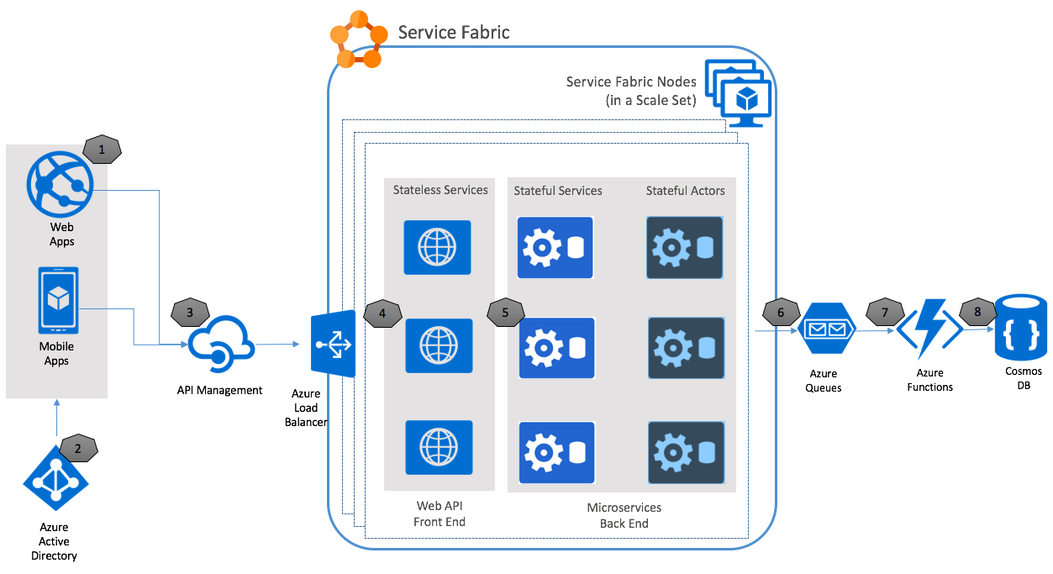
Preferred solution
Notes:
This preferred solution is just one of many viable options
From a high-level:
Starting with #1 on the left, Contoso Events will have both web and mobile applications that consume the back-end APIs for the solution.
Users will authenticate to applications using tokens issued by Azure AD B2C.
We will use an API Management layer as a gateway to all HTTP Web APIs exposed by the solution. It will be configured to authorize tokens issued by trusted Azure B2C tenants. This can be expanded to additional token issuers for third parties in future.
Requests to HTTP Web APIs at the front end will go through Azure Load Balancer and distribute across the available Service Fabric nodes in the cluster.
We will implement Business functionality through stateful services and actors, which will be called by Web APIs. These compose the microservices back end, which will sync their data back to the Cosmos DB instance for ad-hoc queries, by writing the jobs to an Azure queue.
An Azure Function will handle processing the queue and updating the TicketOrders and related collections in Cosmos DB, according to business rules.

Slide 31
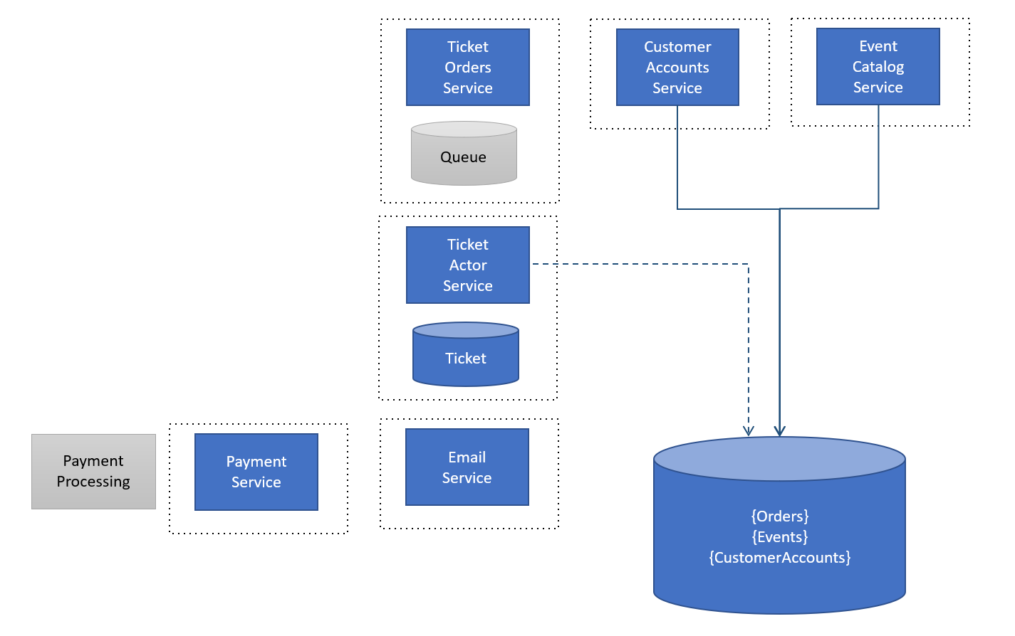
Preferred solution
Notes:
Here is a high-level architecture of the core services that compose the new microservices architecture, as well as the state they hold.
The Ticket Orders Service, on top of the diagram, will take advantage of reliable queues provided by Service Fabric to persist requests.
The Ticket Actor Service processes orders in the queue, and represents a single instance of an order and its processing workflow and state.
When an order is processed, the state is externalized for shared read only services to support aggregation across other data and to optimize reads.

Slide 32
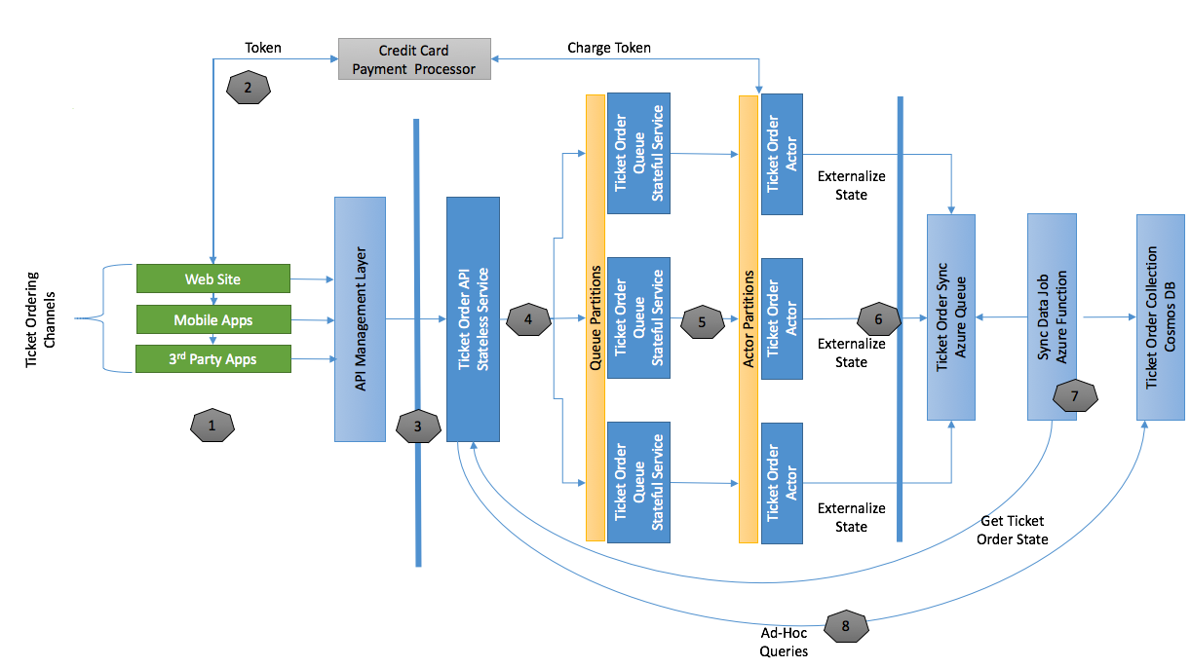
Preferred solution
Scalability of ticket orders
Notes:
Illustrate in more detail the Service Fabric services and components participating in a ticket ordering request.
This diagram illustrates the Service Fabric services and components participating in a ticket ordering request.
The left-hand side of the diagram shows the various ticket ordering channels, such as the Contoso Events consumer web site and mobile applications, as well as third parties who build applications that place ticket orders.
Following the numbered steps, the UI will pre-flight the credit card charge from the order page and supply the resulting token to the back-end processing of the order.
All ticket order requests will call the Ticket Order API through the API Management layer, which will queue the request for processing, passing the token for credit card validation, order details, and any other information required to complete the request asynchronously.
The Ticket Order Queue stateful service will process these requests by instantiating a Ticket Order Actor to handle the processing workflow. This actor is responsible for charging the credit card, finalizing the order, and notifying the customer to give them access to their order.
The actor will also write to a Ticket Order Sync queue to offload sending order data to Cosmos DB for reports, analytics, and related ad-hoc queries.
An Azure Function will read from the queue and handle updates to Cosmos DB. In order to ensure the latest data is always persisted, the function will retrieve the latest order state and update the Cosmos DB Ticket Orders collection.
Web APIs will expose data from Cosmos DB for additional ad-hoc queries against ticket orders.

Slide 33
Preferred solution
Scalability of ticket orders
API Management used to meet demand and high-availability requirements
Ticker Order API offloads requests to Ticket Order Queue using Service Fabric
Ticket Order Actor handles processing
Azure Function persists orders in Cosmos DB
Notes:
Describe the scalability features of this design, including any partitioning strategies that are applicable.
API Management Premium features support scaling and multi-region topologies to meet demand and high availability requirements.
The stateless Ticket Order API offloads valid requests to the stateful Ticket Order Queue. This queue is partitioned by instance count so that requests can be distributed by Service Fabric to the appropriate node or service instance according to availability to process the message.
The stateful Ticket Order Queue is partitioned by instance count (from 1 to n).
When the stateless Ticket Order API offloads valid requests to this queue, those requests are randomly distributed by Service Fabric across these partitions, removing the bottleneck of writes to the queue, thanks to parallel distribution.
The stateful Ticket Order Actor handles processing from this queue and given the number of parallel orders helps the solution to scale by maintaining the state of any number of parallel orders.
The actor is partitioned by order id, which allows for very fine-grained distribution of state, per order, across the cluster.
Millions of these can exist and distribute across the cluster and inactive actors are evicted from memory automatically to conserve resources.
Describe the resiliency of this use case. How can you create an asynchronous ticket order request and guarantee processing? Are there any potential points of failure? How will you address those?
Web applications will not report success unless the Payment Processing succeeds and the order is successfully queued. The queue does not report successful receipt of the message until a quorum is reached.
All Web API calls go through API Management, which can be scaled within a region, or deployed to multiple regions.
The Ticket Order Actor does not remove the order from the queue unless it can successfully process its workflow and save to the Order Sync Queue.
The Azure Function that processes the Order Sync Queue removes messages from the queue if processing is successful to Cosmos DB.
Any of these messages that can’t be processed are moved to a poison queue, to be retried or processed again through another mechanism.
For additional visibility into queue / function processing errors it is good practice to monitor queue sizes that pass a reasonable threshold of standard solution behavior.
Describe how you will enable external clients to reach stateless HTTP services exposed from the Azure load balancer.
When you publish a stateless HTTP service the Service Fabric provides a relative URL to the service according to the configuration you supply.
This way, multiple HTTP services can be deployed to a single node and still be uniquely addressable at port 80 or 443.
In the case of this solution, the API Management layer will consume those endpoints and forward requests.

Slide 34

Preferred solution
Improving DevOps workflows
Visual Studio Service Fabric solution
Upgrade application to preserve state
Service Fabric performance counters drive auto-scaling
Service Fabric inherently provides HA
Notes:
How would you structure the Visual Studio solution so that developers can run, debug and publish the entire solution, but also be able to publish and upgrade individual microservices (could be one or more service grouped together)?
A typical Service Fabric solution has a top-level application that can be used to publish all services associated with it. To publish the entire suite of services in a solution you can add all services to this top-level application.
You can create additional Service Fabric applications in the solution that isolate specific services for deployment.
Describe to the customer how they can upgrade services in situ and preserve state; handle rollback and roll forward; and service self-healing features.
When an application is deployed, you can choose to “upgrade” the application. This preserves any state associated with stateful services if applicable. This will retire previous versions once they complete requests in process, while sending new requests to the new version of the service.
If during the upgrade process there is a problem with the services being deployed, the upgrade is rolled back and the previous version of the services continue to operate.
If the Service Fabric runtime detects any service instances are no longer operational, new instances of the service are initialized to maintain the required minimum instances for the service.
Explain how the Service Fabric cluster handles auto-scaling. How does Service Fabric help the customer to make better utilization of their compute resources?
Currently, performance counters emitted by the Service Fabric cluster drive auto-scaling. You can set up a base requirement for minimum nodes in the cluster (based on reliability level chosen) and configure auto-scale rules to scale up or down within that range, as the available nodes in the cluster become fully or less utilized.
When you deploy services, they are distributed across the available nodes in the Service Fabric cluster – including replicas for stateful services. Service Fabric will ensure that services are distributed across nodes according to any placement constraints, while ensuring that nodes are densely populated.
How would you plan for high availability (HA) for Service Fabric in this solution?
Service Fabric inherently provides high availability within the cluster region.
You achieve multi-region high availability for disaster recovery scenarios by using the backup/restore capability of stateful services.
You can also create real time high availability across regions by configuring Traffic Manager to route traffic to both regions. In this case, any stateful services should be capable of reloading their latest state from external storage if not present in the region’s cluster.

Slide 35
Preferred solution
Improving DevOps workflows
Problems and failures reported in Service Fabric health manager
Cluster security provisioned up front
Service Fabric updates handled by Microsoft
Notes:
Explain to the customer how Service Fabric can help the customer have visibility into overall solution health.
If you report problems and failures to the Azure Service Fabric health manager from your service code, you can use standard health monitoring tools that Service Fabric provides to check the health status.
For example, you can report configuration errors that would prevent the solution from reliable operation, and report these as exceptions to the Service Fabric.
Exceptions that are detected while the Service Fabric tries to perform upgrades will trigger a rollback operation to avoid introducing this failure into the system.
How can you update cluster settings after the fact? What kind of settings might you want to update?
You cannot change the security of the cluster after provisioning it, so it is important to set the cluster up as a secure cluster, from the beginning.
You may need to modify the ARM template you used to create the cluster, add new ports you want to expose, add new node types for scale tiers, and then re-apply the template to safely upgrade the cluster nodes.
How will you keep your cluster up to date with the latest Service Fabric SDK?
Microsoft updates the runtime SDK on all clusters, unless the cluster is in an unhealthy state. You do not have to update the cluster yourself to keep it current.

Slide 36

Preferred solution
Controlling Access to APIs
API publishing tools and Swagger
Leverage API Management features
All API consumers issued a key
Employ Azure AD B2C for customer login
Notes:
Describe how API Management may be useful to control access to APIs exposed by the solution.
Initially the solution will benefit from API publishing tools and swagger, API security policy and token validation and internal applications that can be created as pre-assigned API consumers without a sophisticated setup.
Eventually, as the partner ecosystem is built out, the customer will want to leverage many more API Management features such as API consumer onboarding and policy management, API consumer self-service features such via the consumer portal, blog, API documentation, incident reporting tools and API consumer throttling and usage metrics reporting.
How would you identify the user and the API consumer or application?
All consumers, including internal applications, will be issued a consumer key.
The solution will employ Azure Active Directory B2C for customer login, and will use the same mechanism for API security. API Management policy will be set up to authorize access only to callers with a signed Azure AD token (JWT) issued by the solution tenant, for consumer applications. Corporate applications may introduce another Azure AD tenant that syncs with their internal AD, for example.

Slide 37
Preferred objections handling
Is Service Fabric the right solution?
Service Fabric has been battle tested for many years prior to becoming generally available. In fact, Service Fabric is the underlying foundation for Azure’s own SQL DB and Cosmos DB services among other high traffic applications such as the very popular Halo game.
As for choosing between Service Fabric and App Services or SQL DB the benefits of the former include:
The ability to deploy individual application services without concern over the target infrastructure – let Service Fabric decide the target nodes appropriate for each tier and service type.
Simplified approach to managing data persistence with stateful services.
Microservices design from the ground up on a platform that is specifically designed for that purpose – with the ability to scale.
Notes:
While we are interested in the microservices approach, we are still comparing Service Fabric with PaaS features such as App Services and SQL DB. How mature is Service Fabric by comparison?
Service Fabric has been battle tested for many years prior to becoming generally available. In fact, Service Fabric is the underlying foundation for Azure’s own SQL DB and Cosmos DB services among other high traffic applications such as the very popular Halo game.
As for choosing between Service Fabric and App Services or SQL DB the benefits of the former include:
The ability to deploy individual application services without concern over the target infrastructure – let Service Fabric decide the target nodes appropriate for each tier and service type.
Simplified approach to managing data persistence with stateful services.
Microservices design from the ground up on a platform that is specifically designed for that purpose – with the ability to scale.

Slide 38
Preferred objections handling
Which of our existing skills can be applied to microservices and Service Fabric?
Service Fabric is a natural transition for .NET developers in many respects:
They can continue to use Visual Studio for development, debugging and publishing applications.
They can leverage Service Fabric project templates to kick-start their understanding of Service Fabric services.
The programming model for services is familiar.
Working with stateful services is also familiar in the sense that state is defined via objects (POCO) and serialized as part of the service implementation.
Notes:
Microservices architectures are completely new to the Contoso Events team. If we were to go forward with Service Fabric, we would like to understand what skills the team can carry forward, and how much of a learning curve exists.
Service Fabric is a natural transition for .NET developers in many respects:
They can continue to use Visual Studio for development, debugging and publishing applications
They can leverage Service Fabric project templates to kick-start their understanding of Service Fabric services.
The programming model for services is familiar.
Working with stateful services is also familiar in the sense that state is defined via objects (POCO) and serialized as part of the service implementation.

Slide 39
Preferred objections handling
Can stateful services or actors help us with ticket ordering throughput?
Stateful services are backed by robust and reliable storage. When data (state) is saved by the service, it is not confirmed (committed) unless a quorum is reached.
By using the stateful actor, not only is the persistence of the actual ticket order handled by the Service Fabric at scale, but the actor can be wholly responsible for the workflow required to complete the order.
When updates to this actor are required, the existing state is preserved, any active instances can continue completing their work, and the new actor functionality or state requirements can be rolled out safely across the nodes in the cluster, eventually retiring the previous version.
Notes:
We’d like to understand if stateful services or stateful actors will help us with ticket ordering throughput, workflow and state management, and easier rollouts of changes to this process.
Stateful services are backed by robust and reliable storage. When data (state) is saved by the service, it is not confirmed (committed) unless a quorum is reached.
By using the stateful actor, not only is the persistence of the actual ticket order handled by the Service Fabric at scale, but the actor can be wholly responsible for the workflow required to complete the order
When updates to this actor are required, the existing state is preserved, any active instances can continue completing their work, and the new actor functionality or state requirements can be rolled out safely across the nodes in the cluster, eventually retiring the previous version.

Slide 40
Preferred objections handling
How and where can stateful services and actors help us?
Stateful services make it easy to save and retrieve state, and distribute that state for higher availability by using a partitioning strategy. Each partition has its own replica set for reliability.
You can replicate this state to an external store like Cosmos DB to support ad-hoc querying, analytics and disaster recovery.
Notes:
We are not clear how and where to incorporate stateful services and actors alongside other storage such as Cosmos DB. We need the ability to support robust ad-hoc queries against our system data such as events, customers, orders and related metrics – but would like to take advantage of the performance and reliability of Service Fabric stateful options as well.
Stateful services make it easy to save and retrieve state, and distribute that state for higher availability by using a partitioning strategy. Each partition has its own replica set for reliability.
You can replicate this state to an external store like Cosmos DB to support ad-hoc querying, analytics and disaster recovery.

Slide 41
Preferred objections handling
How can Azure Functions be leveraged?
While it is possible to create functions that run behind API Management endpoints, they are best employed for decoupled, asynchronous background operations that can be run at scale without concern for the specific server running that operation.
In this solution, Azure Functions allowed for decoupling the external storage location of orders, without the need to update Service Fabric configurations on change. It also allowed for a separate scale-out tier for that work.
In a solution such as a mobile application back end, functions could be useful if they don’t need to comingle with other solution aspects – such as acting as their own microservice with a targeted purpose.
Notes:
Could we consider Azure Functions as an alternative back end implementation for our APIs?
While it is possible to create functions that run behind API Management endpoints, they are best employed for decoupled, asynchronous background operations that can be run at scale without concern for the specific server running that operation.
In this solution, Azure Functions allowed for decoupling the external storage location of orders, without the need to update Service Fabric configurations on change. It also allowed for a separate scale-out tier for that work.
In a solution such as a mobile application back end, functions could be useful if they don’t need to comingle with other solution aspects – such as acting as their own microservice with a targeted purpose.

Slide 42
Customer quote
“With Service Fabric we are able to move to microservices architecture without the DevOps headache. Service Fabric provides so much to support deployment, compute utilization, health monitoring and recovery – we could leverage the same team while increasing the size of our solution and feature set!”
—Steve Dormer, CIO at Contoso Events

